Slide 1
Extension Lesson
Biodiversity and Impacts to the Environment.

Slide 2
In the Lesson you will:
Watch and take notes on the different impacts to our environment to explain impacts to biodiversity.
At the end of the lesson you will be able to:
Define biodiversity and the impacts humans have on biodiversity and our environment.

Slide 3
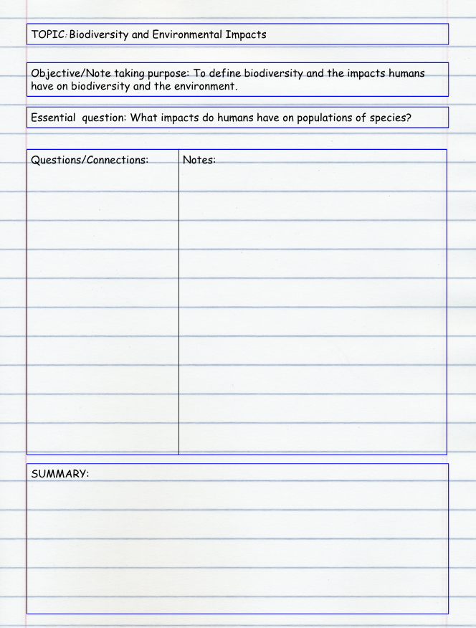
Go to the next full page of your INB.
Create a note taking page in your INB by copying this note taking template into your INB.
Make sure to write out the Topic, the Objective, the Essential Question.
Divide your page as shown with a column for Questions/Connections; Notes and a Summary.
You will review video materials on the next slides and record your thinking on the note taking form you have created in your INB. Create additional note taking pages as needed.

Slide 4
Note taking expectations:
As you watch each video, pause to record notes.
Turn on closed caption to help read and listen.
Aim to write three bulleted sentences capturing the key ideas you hear from each video.
Write one questions/connection for each video.
Use your notes to compose a 3-5 sentences summary.
Add additional notes taking pages to your INB if you need more space to write.

Slide 5
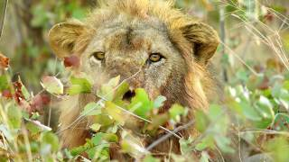
What is biodiversity?

Slide 6

Why is biodiversity important?

Slide 7

Why is biodiversity important?

Slide 8
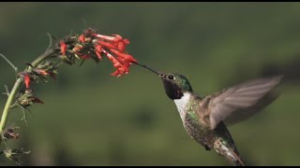
What impacts biodiversity?

Slide 9
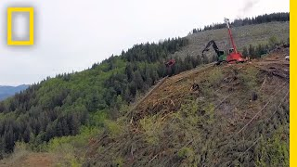
What impacts biodiversity?

Slide 10
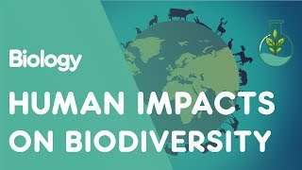
What impacts biodiversity?

Slide 11
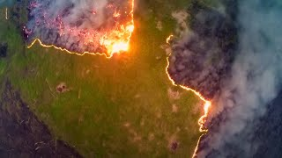
What impacts biodiversity?

Slide 12
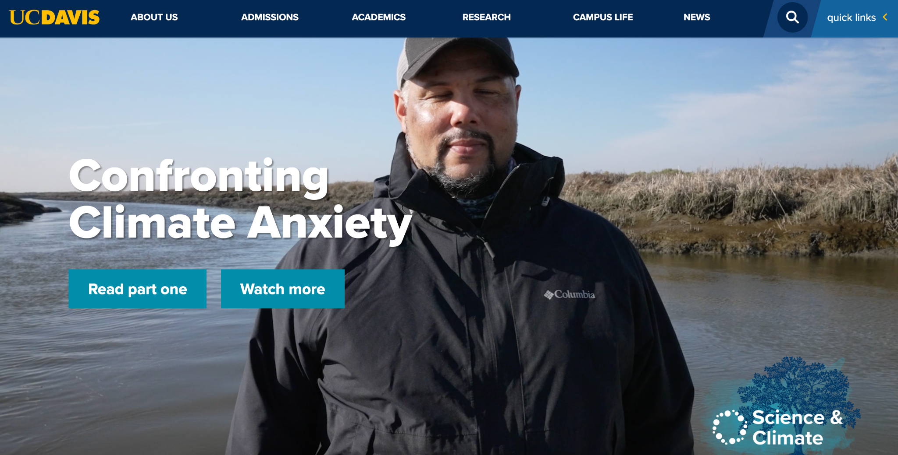
Feeling sad about all of this? You are not alone.
Click on the image to go to the website and press Watch more to see the video when you get to the website.

Slide 13
Extension
Rewrite your note taking summary from your INB on the white board in the Open Collaborative Space. Check in with the teacher before you do this.
Review the list of threatened or endangered species: https://www.worldwildlife.org/species/directory?direction=desc&sort=extinction_status
https://www.iucnredlist.org/search?taxonLevel=Amazing&searchType=species
Pick one organism to research and figure out what the specific threat is to that organism that is causing the population to decline.
In your INB record the name of the species, a sketch of the organism, and your findings on why they are going extinct.

